Slide 1
Alcohol specific deaths in UK
dashboard

Slide 2
Public Health Data
Public health data is used to monitor disease trends, detect outbreaks, and track the spread of diseases over time and across geographic areas.
Analysis of public health data helps in designing and evaluating disease prevention and control programs.
This data helps in understanding the impact of diseases on different population groups, allowing for targeted public health strategies.
The prime example of this is the spread of COVID-19. This pandemic exemplifies how public health data is used in epidemiology to monitor, analyse, and respond to a global health crisis.
Data-driven approaches have been critical in understanding the virus, implementing effective interventions, and ultimately controlling the spread of the disease.

Slide 3
Health care data Vs Public health data
Aspect | Public health data | Health care data
Focus | Population-level health issues, trends, determinants | Individual patient care and clinical outcomes
Purpose | Inform public health policies, programs, interventions | Improve patient care, manage services, support research
Sources | Surveys, registries, vital statistics, environmental data, social determinants | EHRs, claims data, patient registries, clinical trials, patient surveys
Applications | Used by public health agencies, policymakers, community health organizations | Used by healthcare providers, insurers, clinical researchers
Examples | Disease prevalence, health behaviours, social determinants, environmental factors | Patient demographics, medical histories, treatment records, diagnostic test results

Slide 4
Public data - Alcohol specific related deaths in UK
Source Dataset Link : https://shorturl.at/pjmNG (Office for national Statistics).
Alcohol-specific deaths are those directly caused by alcohol consumption, such as alcoholic liver disease etc, and other conditions that are attributable to alcohol.
Objective : To analyse the data on alcohol-specific related deaths in the UK to understand trends, risk factors, and implications for public health.
Dataset : This data covers multiple years and is available in different regions within the UK. This also includes age , gender and other demographic factors.
Key Findings :
The trend of deaths related to alcohol changed over the years.
The Main causes of alcohol related deaths.
Identify regions with higher rates of alcohol-specific deaths.
the impact on men versus women.
Highlight which age groups are most affected.

Slide 5
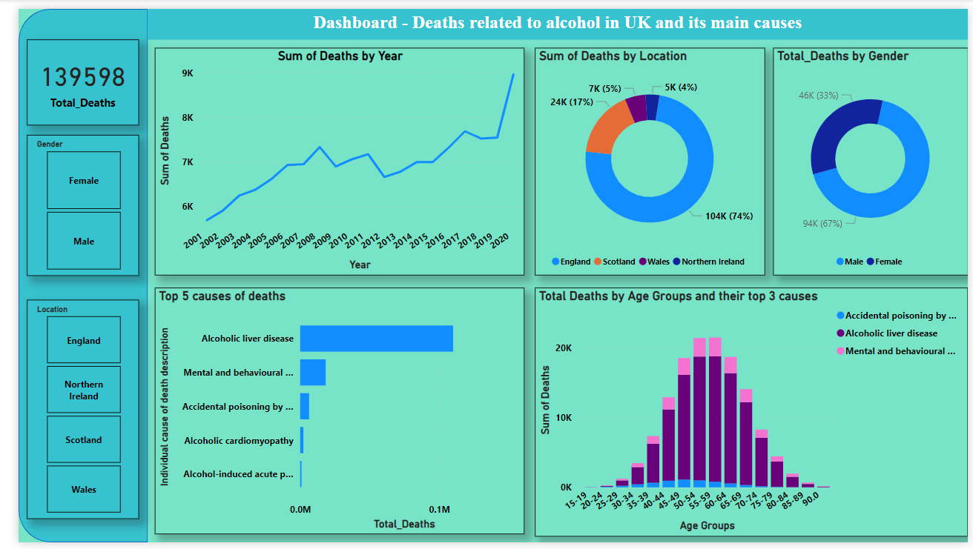
Dashboard – Alcohol Specific Deaths in UK (using Power BI)

Slide 6
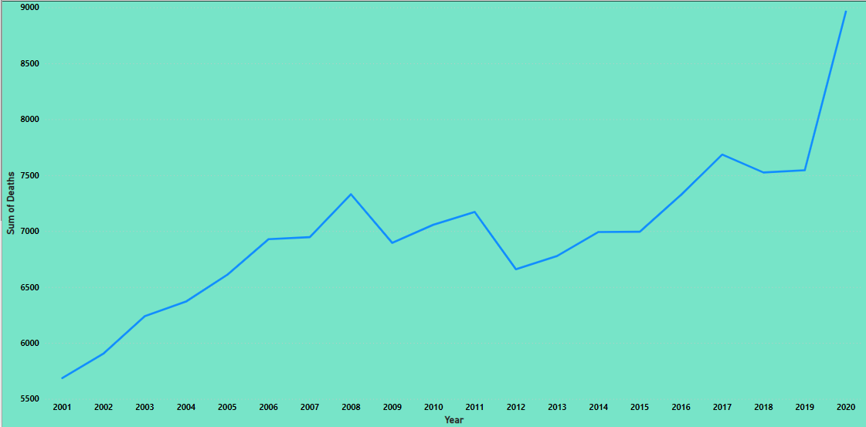
Trend of deaths related to alcohol over the years
we can see the trend of alcohol-specific related deaths in the UK from 2001 to 2020. For the majority of this period, the number of deaths fluctuated, showing slight increases and decreases year-on-year. However, it's particularly noteworthy that there was a significant spike in deaths between 2019 and 2020.
One of the possible reason for the spike is COVID-19 pandemic. Because of the lock down, led to increased level of stress, social isolation which likely contributed to a rise in alcohol consumption.
This clearly implies that providing addiction support services and strengthening mental health during these times are more crucial. By conducting these mental well-being programmes and monitoring the alcohol consumption can help reduce these type of spikes in future.

Slide 7
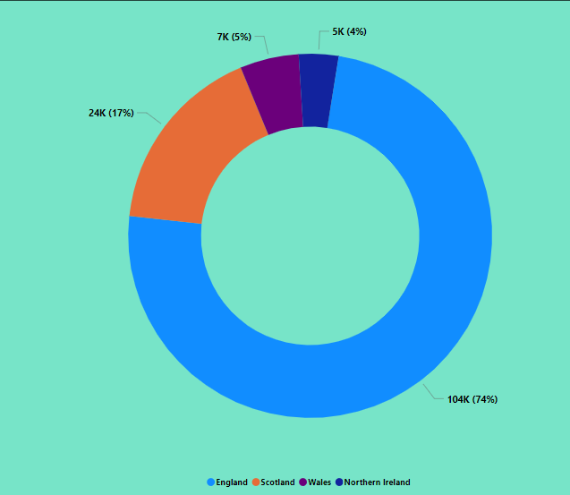
Analysing deaths by specific region
Initially, we can clearly depict that England shows the highest number of alcohol-specific deaths, followed by Scotland, Wales, and Northern Ireland.
But, simply looking at these number of deaths can be misleading without considering the population size of each region. So , It will be better if we visualize this from the context of total population (e.g., deaths per 10,000 people).
When we look at the death rates per capita, we get a clearer picture of the burden of alcohol-related deaths in each region. This approach allows us to see that although England has the highest number of deaths, regions like Scotland might have a higher death rate per capita, indicating a more severe problem relative to their population size.

Slide 8
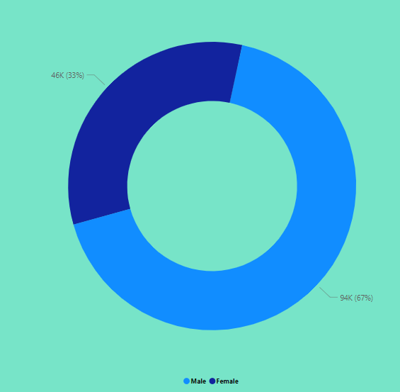
Impact of alcohol related deaths by gender
The chart clearly shows that men experience a higher number of alcohol-related deaths compared to women.
Research indicates that men are more likely to engage in heavy drinking and risky behaviours associated with alcohol. They also tend to start drinking at an earlier age and consume alcohol in higher quantities compared to women.
These behaviours contribute to more severe health outcomes for men, including liver disease, alcohol poisoning, and accidents. Consequently, this leads to higher mortality rates from alcohol-related causes.
Campaigns and treatment programs need to be tailored to address the specific risks and behaviours associated with alcohol use in men

Slide 9
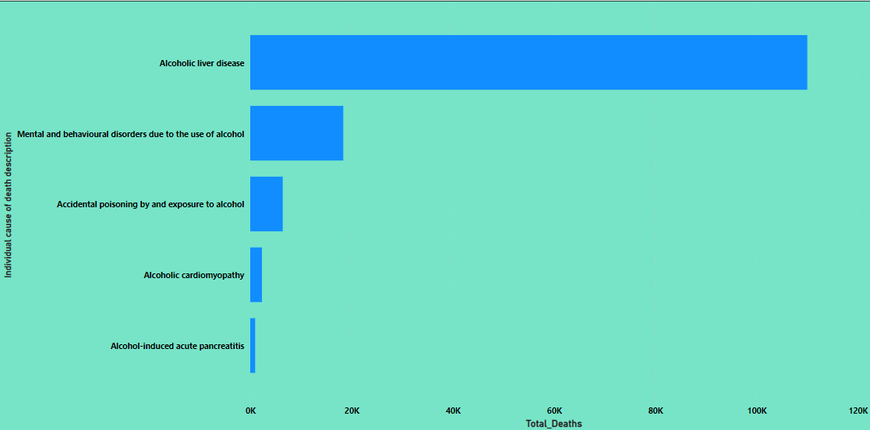
Identifying the Top – 5 causes of deaths
The chart clearly indicates that Alcoholic liver disease is the leading cause, followed by Mental and behavioural disorders due to use of alcohol.
Alcoholic liver disease results from excessive alcohol consumption, leading to severe liver damage and eventually liver failure. This condition is responsible for the highest number of alcohol-related deaths
The second leading cause, Mental and behavioural disorders due to alcohol use, includes a range of conditions such as alcohol dependence and alcohol-induced psychosis. These disorders not only impact mental health but also increasing the risk of death.
Addressing these key causes through comprehensive public health strategies is essential to reducing alcohol-specific deaths and improving overall public health outcomes.

Slide 10
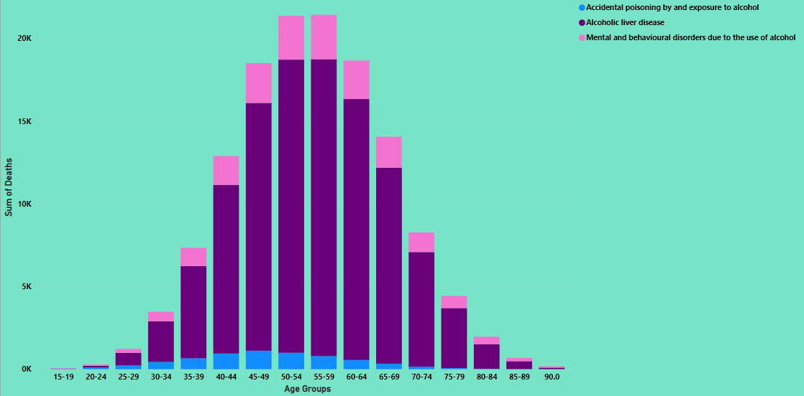
Impact of alcohol consumption on age-groups
The chart reveals a clear trend: the number of deaths increases from the age group 40-44, peaks at 50-54 and 55-59, and then decreases in older age groups. This rising trend in deaths from 40-44 to 55-59 can be attributed to the cumulative effects of prolonged alcohol consumption. Over time, heavy drinking leads to severe health issues, such as liver disease and heart problems, which become more pronounced in middle age.
The decline in deaths in older age groups (60-64 and beyond) can be explained by the survivor effect, where those who survive into older age might have avoided or managed severe alcohol-related conditions better. Additionally, some older adults may reduce alcohol consumption due to health issues or lifestyle changes.
Understanding these age-specific trends is crucial for developing targeted public health strategies. For the 40-59 age group, prevention, early detection, and treatment of alcohol-related diseases are essential to reduce the peak in deaths. For older age groups, comprehensive care and support for managing chronic conditions and reducing the impact of long-term alcohol use are vital.

Slide 11
Conclusion
The analysis of alcohol-specific deaths in the UK reveals critical insights into the trends and causes across different demographics. Key findings include:
Trend Analysis: Alcohol-specific deaths show a significant rise over the years specifically between 2020 and 2021.
Primary Causes: Alcoholic liver disease is the predominant cause, followed by mental and behavioural disorders due to alcohol use and accidental poisoning.
Demographic Insights: England exhibits the highest number of deaths, but this must be considered relative to its larger population. Men are disproportionately affected compared to women.
Age Group Insights: The highest number of deaths occurs in the 50-54 and 55-59 age groups, likely due to cumulative effects of long-term alcohol use and related health complications.
These findings highlight the urgent need for targeted public health interventions to address the specific needs of high-risk demographics, particularly middle-aged individuals, to reduce alcohol-related mortality.
By Designing targeted awareness campaigns focusing on high-risk age groups and the dangers of long-term alcohol consumption. By implementing these enhancements, public health authorities can develop more effective strategies to reduce alcohol-specific deaths and improve overall public health outcomes.

